Slide 1
Lectures on HPC/Parallel Computing Lecture 3
Andrew Pensoneault

Slide 2
Overview
(Very) Brief Intro to C
Intro to MPI
Synchronization
Send/Recv
Gather/Scatter

Slide 3
Brief Intro TO C
C is a general-purpose, procedural computer programming language.
It is designed to be compiled to machine instructions
Thus, unlike Python or MATLAB, we must compile the program before executing it ever time we alter the code
On the cluster, we must first load the compiling (and openmpi) before starting
Run the commands (or put into .bash_startup)
$ module load gcc
$ module load openmpi

Slide 4
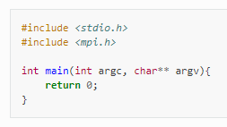
Simple Program in C
C gets most of its functionality via libraries, with one of the most commonly included one being the standard library
Libraries are included via a #include <header.h> statement at the top of the script.
We shall create our first C program by creating a main function and including the two header files stdio.h and mpi.h

Slide 5
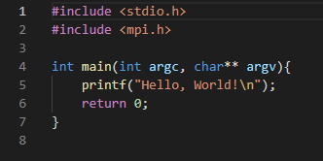
Hello WOrld Program in C
We will now create our basic hello world function
printf is included in the standard io library, and outputs the text to the console
To compile the program run the command
$ gcc helloworld.c –o helloworld
To run the program run the command
$ ./helloworld

Slide 6
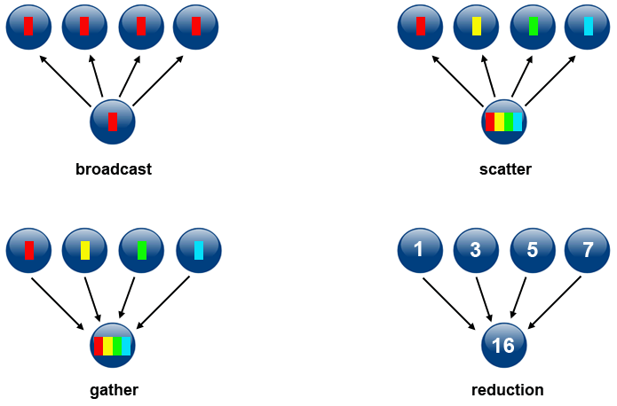
INTRO to MPI
Message Passing Interface (MPI) is a standardized and portable message-passing standard designed to function on parallel computing architectures.

Slide 7
MPI Hello WOrld Program in C
To make use of the parallel resources, we must
a) initialize our processes
b) perform the tasks
c) clean up and end our processes
MPI_Init(): This function initializes the MPI environment. It takes in the addresses of the C command line arguments argc and argv.
MPI_Comm_size(): This function returns the total size of the environment via quantity of processes. The function takes in the MPI environment, and the memory address of an integer variable.
MPI_Comm_rank(): This function returns the process id of the processor that called the function. The function takes in the MPI environment, and the memory address of an integer variable.
MPI_Finalize(): This function cleans up the MPI environment and ends MPI communications.

Slide 8
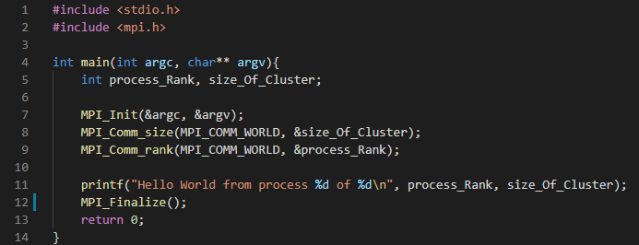
MPI Hello WOrld Program in C
To compile the program run the command
$ mpicc mpi_helloworld.c –o mpihelloworld
To run the program run the command
$ mpirun –np 4 ./helloworld

Slide 9
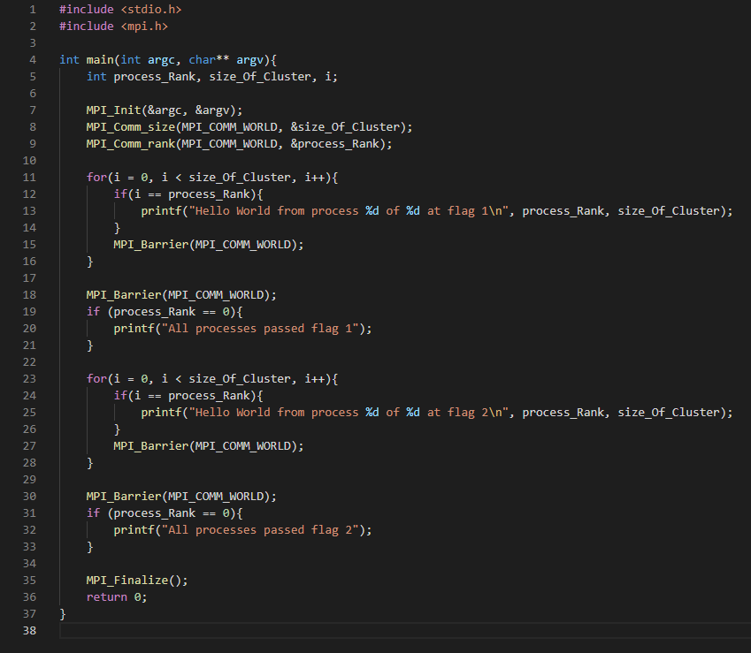
Synchronization with MPI
When a program is running, MPI starts a specified number of copies of the program running in parallel, and each process operates independently of the rest
To ensure thread safety, once a process reaches a point, we may wish to have it wait.
MPI_Barrier(): This function blocks all MPI processes in the given communicator until they all call this routine.

Slide 10
Message Passing with MPI
We can enable passaging of messages between multiple processes via the following functions
MPI_Send(const void* buffer_send,
int count_send,
MPI_Datatype datatype_send,
void* buffer_recv,
int count_recv,
MPI_Datatype datatype_recv,
int root,
MPI_Comm communicator)
buffer_send - The buffer containing the data to dispatch from the root process.
count_send - The number of elements to send to each process, not the total number of elements in the send buffer. For non-root processes, the send parameters like this one are ignored.
datatype_send - The type of one send buffer element. For non-root processes, the send parameters like this one are ignored.
buffer_recv - The buffer in which store the data dispatched.
count_recv - The number of elements in the receive buffer.
datatype_recv - The type of one receive buffer element. root The rank of the root process, which will dispatch the data to scatter.
Communicator - The communicator in which the scatter takes place.

Slide 11
Message Passing with MPI
We can enable passaging of messages between multiple processes via the following functions
MPI_recv(void* buffer,
int count,
MPI_Datatype datatype,
int sender,
int tag,
MPI_Comm communicator,
MPI_Status* status);
Buffer - The buffer in which receive the message.
Count - The number of elements in the buffer given. The number of elements in the message to receive must therefore be less than or equal to that value.
Datatype - The type of one buffer element.
Sender - The rank of the sender MPI process. If there is no restriction on the sender's rank, MPI_ANY_SOURCE can be passed.
tag - The tag to require from the message. If no tag is required, MPI_ANY_TAG can be passed.
communicator - The communicator in which the communication takes place.
status - The variable in which store the status of the receive operation. Pass MPI_STATUS_IGNORE if unused.

Slide 12
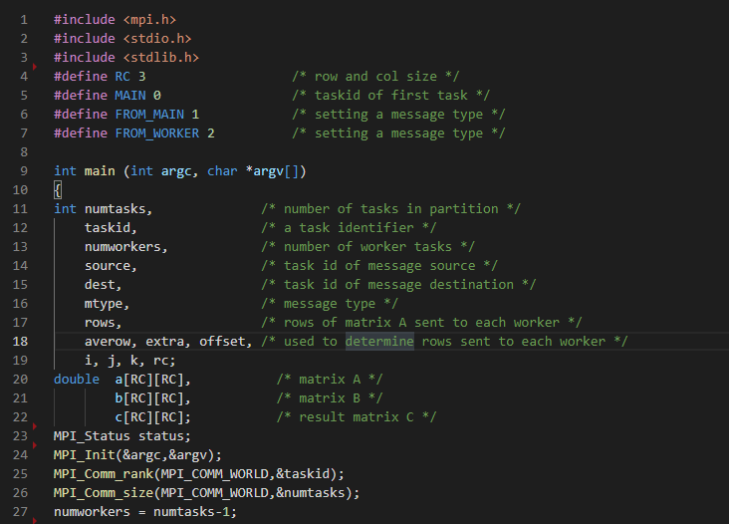
Matrix Multiplication

Slide 13
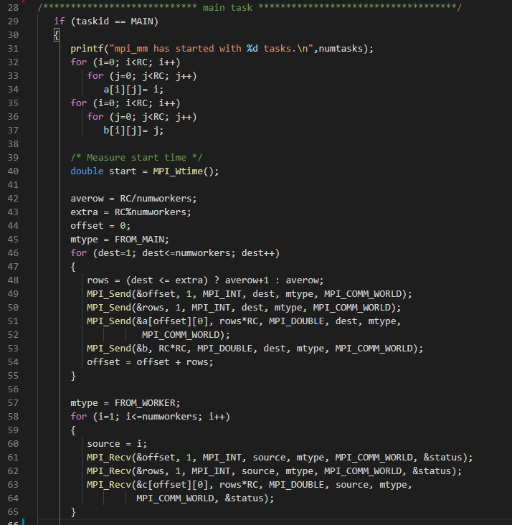
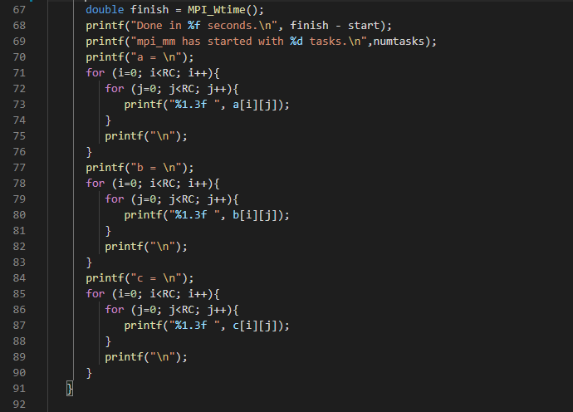
Matrix Multiplication

Slide 14
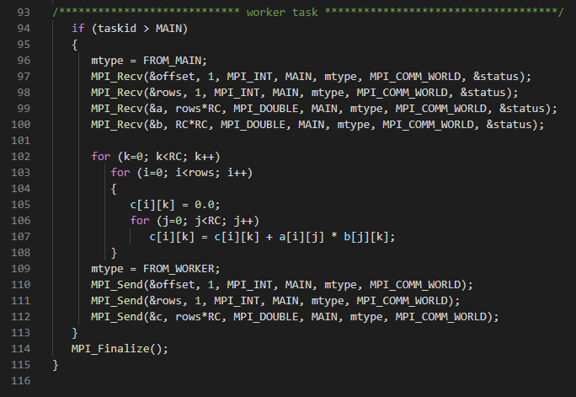
Matrix Multiplication

Slide 15
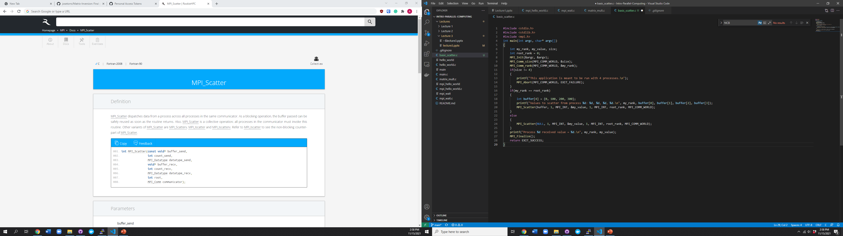
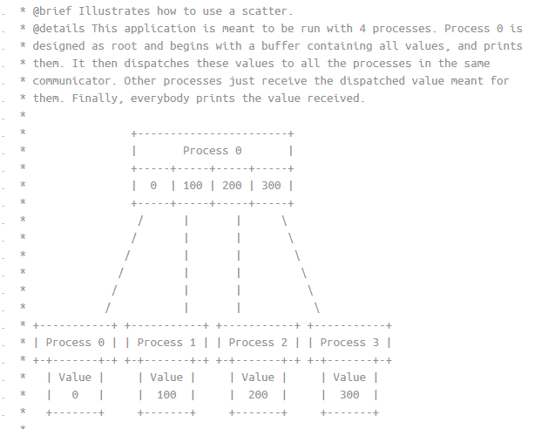
MPI_scatter

Slide 16
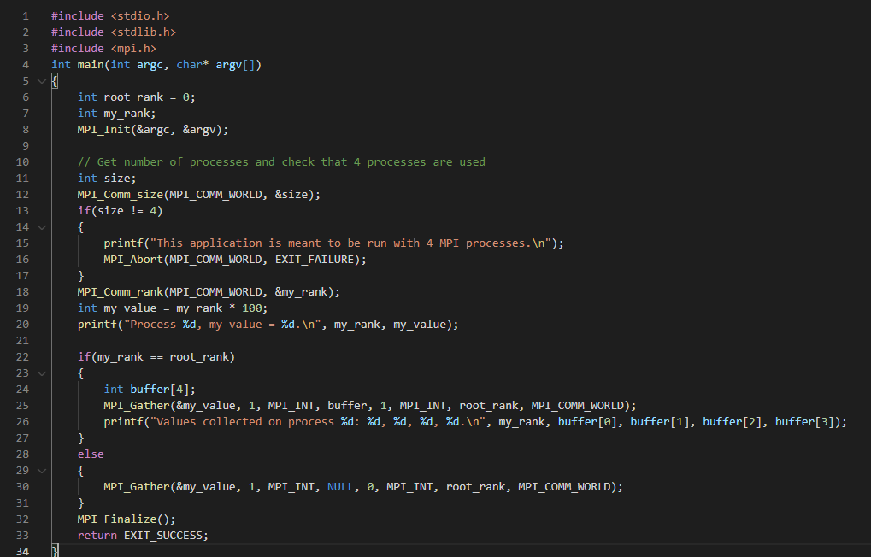
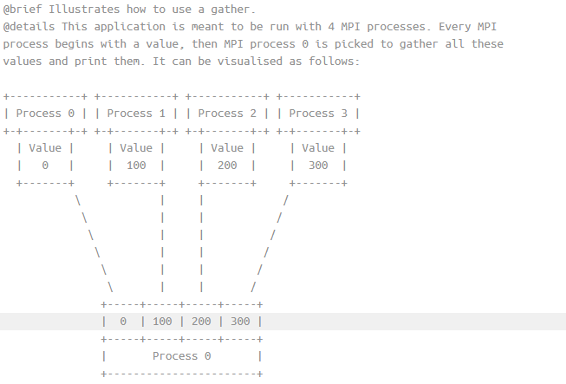
MPI_gATHER

